Slide 1

CSD2006 Introduction to Edge Computing
Module I

Slide 2
Module I –L1
After going through this topic student should be able to
CO1:Define Edge Computing
CO2:Why Edge Computing is Needed
CO3:What is meant by Edge AI?
CO4:why Edge AI is a cutting-edge technology

Slide 3
Introduction
Edge Computing is a modern computing paradigm that brings data processing and computation closer to the data source such as IoT devices, sensors, and gateways—instead of centralized cloud.
The “edge” refers to the edge of the network, where the data is generated by processing data locally, Edge Computing reduces the time and bandwidth needed to send data to distant cloud servers.
Processes the data directly on the nearby device.Enhances speed, reliability, and privacy.
Example: A smart camera detecting motion and alerting without uploading video to the cloud

Slide 4
Why Edge Computing is Needed
Traditional Cloud Computing involves sending all data from IoT devices to remote data centers for processing However, this causes:
High latency (delay)
due to long-distance data travel
Network congestion from large data transfers
Security concerns while transmitting sensitive data
To overcome these limitations, Edge Computing processes data locally or near the data source.

Slide 5
Working Principle
The working of Edge Computing involves three main stages:
Data Generation: IoT devices (e.g., sensors, cameras, smart meters) generate data continuously.
Local Processing (Edge Nodes): Small computing devices (like routers, gateways, or micro servers) near the data source process and analyze data in real time.
Cloud Interaction (Optional): Only selected or summarized data is sent to the cloud for further storage, analysis, or long-term decision-making.

Slide 6
OVERVIEW OF EDGE AI
Edge Computing Concept:
Moves data processing from centralized cloud data centers to servers closer to end users.Aims to improve quality of experience (QoE) for users of mobile and fixed Internet-connected devices.Especially important for wireless networks and latency-sensitive applications.
Edge AI: is a computing paradigm in which artificial intelligence models and algorithms are deployed and executed directly on edge devices or edge nodes

Slide 7
OVERVIEW OF EDGE AI
Edge Ai: Edge AI refers to deploying artificial intelligence algorithms directly on edge devices such as sensors, mobile devices, and IoT nodes instead cloud servers.
Location of Intelligence:
AI processing is performed near the data source (network edge), reducing dependency on centralized cloud infrastructure.
Benefits of Edge AI:
Reduced latency and faster decision-making
Improved privacy and security by minimizing data transmission to the cloud
Efficient data processing and reduced bandwidth usage

Slide 8
Cutting-Edge - Computing
Definition:Cutting Edge computing places computing and storage resources close to users and data sources to overcome cloud computing issues.
Need for Cutting Edge Computing:Addresses cloud limitations such as high latency, jitter, and bandwidth constraints, especially in IoT and wireless networks.
Cutting Edge AI refers to deploying artificial intelligence algorithms directly on edge devices such as sensors, mobile devices, and IoT nodes instead of relying on cloud servers.Data collection and processing through by Training Machine Learning models at the Edge

Slide 9
Conti...
Training Machine Learning models Integration results - AI +IoT=AIoT
Real-Time Data Processing:
Capabilities of Edge AI Systems
Subfields of Artificial Intelligence:
Applications of Computational Intelligence:
M2M, IIoT Communication
Smartphones and tablets
Smart speakers and wearables
Cameras, sensors, robotics

Slide 10
Module I –L2
After going through this topic student should be able to
CO1: Explain Cloud AI
CO2: Define Edge AI
CO3: Difference between Cloud AI and Edge AI

Slide 11
DIFFERENCES BETWEEN CLOUD AI AND EDGE AI
Cloud AI –
Uses centralized cloud servers with high computational power and storage.
Few constraints on model size, memory, and processing speed.
High cost associated
Long-term cloud storage
Continuous data transmission
Performance depends on network connectivity.
Privacy-sensitive data may need to be transmitted off-premises concerns.

Slide 12
Conti.....
Edge AI –
AI processing occurs on-far device or near the data source or end device itself.
Devices have limited RAM, storage, processing power, and energy.
Requires lightweight, optimized ML models.
Results:
Low latency
High reliability
Improved data privacy
Devices continue functioning even with poor or intermittent internet connectivity.
Eliminates the need for data to leave the premises.

Slide 13
conti...

Slide 14
Comparison Between Cloud AI and Edge AI

Slide 15
Comparison Between Cloud AI and Edge AI

Slide 16
Module I –L3
After going through this topic student should be able to
CO1: How Edge AI supports real-time analytics.
CO2: Describe the benefits of performing analytics

Slide 17
Benefits of Edge AI in real-time analytics

Slide 18
Benefits of Edge AI in real-time analytics,
Edge computing shifts data processing and storage to the network edge, close to data sources.
Enables millisecond-level processing using AI without constant internet connectivity.
Improves compute performance, data security, and business continuity.
Reduces operational costs and enhances AI-enabled application functionality.
Supports machine learning, deep learning inference, and IoT devices without cloud dependency.

Slide 19
conti..
Reduced Latency
Local processing eliminates round-trip delay to cloud servers.
Real-Time Analytics
Enables immediate insights at sensor and IoT device level.
Higher Processing Speed
Faster execution compared to cloud-based AI processing.
Reduced Bandwidth and Cost
Minimizes internet traffic and cloud storage expenses.

Slide 20
conti..
Improved Data Security
Sensitive data remains on-device, reducing exposure to cyber threats.
Scalability
Handles large volumes of data (e.g., video streams) without cloud overload.
Improved Reliability
Continues functioning even during connectivity description.
Reduced Power Consumption
Less data transmission leads to lower network-related power usage.

Slide 21
Module I –L4
CO1: Explain current trends driving the adoption of Edge AI.
CO2: Describe how Edge AI is applied in smart cities or healthcare
CO3:In a smart city, multiple IoT devices like traffic cameras and environmental sensors continuously send data to Edge Nodes for processing. However, the Edge Nodes often experience overloading due to the high volume of data and real-time processing demands. Identify the Critical Issues of Edge Nodes

Slide 22
Smart City

Slide 23
Current Trends and Applications
Smart Transit (Intelligent Transportation)
Cities aim to reduce:
Traffic congestion
Fuel consumption
Delays due to poor traffic management
Edge servers analyze data from:
Smart traffic sensors
CCTV cameras
Enables:
Adaptive traffic signal control
Real-time vehicle movement analysis

Slide 24
conti....
Intelligent parking systems
provide location-based parking availability.
Limitations of cloud computing:
High latency
Lack of real-time safety guarantees
Edge computing enables:
Faster decision-making
Low-latency responses for autonomous vehicles
Smart industries
UAV

Slide 25
Current Problems and Emerging Trends in Edge AI

Slide 26
Current Problems and Emerging Trends in Edge AI
Increased Adoption
More devices capable of local AI processing
Edge AI becoming mainstream
Faster Processing
Advanced processors on edge devices
Improved AI performance and response times
Improved Accuracy
Better data quality
Advanced algorithms
Multi-source data integration

Slide 27
conti...
Privacy and Security
Local data processing raises privacy concerns
Federated learning reduces raw data sharing
Energy Efficiency
Battery-powered edge devices need low-power designs
Use of quantization and model compression
Edge-to-Cloud Integration
Hybrid systems combine strengths of both
Cloud for model training
Edge for real-time decision

Slide 28
Module I –L5
CO1:Explain the future prospects of edge computing in next-generation networks.
CO2:Describe how Edge AI will influence future IoT applications.

Slide 29
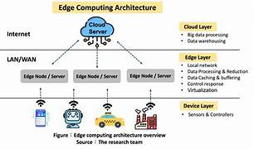
Future prospects of Edge

Slide 30
Future prospects of Edge/EdgeAI
Resource Computation at the Edge
Most edge hardware is not designed for heavy computation.
Software-based solutions are emerging to overcome limitations.
Examples include:
Cloud servers with radio applications
Virtual machine (VM) hosting at the edge
Finding Suitable Edge Nodes and Resources
• Discovery and trust are critical issues in edge networks.
• Mobile devices must:
Identify suitable edge nodes
Ensure trustworthiness of edge resources

Slide 31
conti...
Edge AI: Future Directions
Deploying AI in resource-constrained environments requires:
Efficient computing resource management
Secure data handling
Reliable network connectivity
Real-time processing capability
before deployment:
Can edge devices support AI model complexity?
How will data and models be transmitted?
Which network infrastructure will be used?
How will sensitive data privacy be ensured?

Slide 32
conti...
This improves response time, reliability, energy efficiency, and privacy,
Edge AI will enable IoT devices to perform local intelligence,train AI models locally and share only model updates instead of raw data making IoT systems more scalable and autonomous
saving network energy and lowering data center workloads. Optimized local processing and AI model compression also contribute more energy-efficient computing.
This approach improves privacy, reduces network load, and enables collaborative intelligence, making it suitable for large-scale distributed edge systems

Slide 33
Module I –L6
Explain the differences between Edge, Fog, and Cloud computing

Slide 34
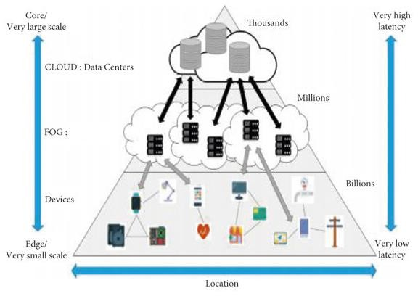
Cloud Vs Edge

Slide 35
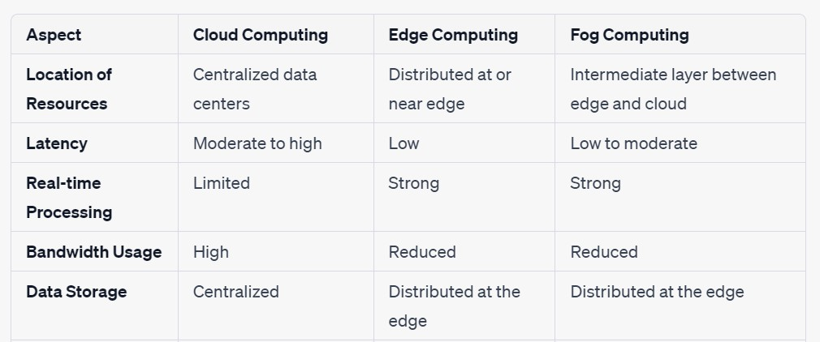
Cloud Vs Edge Vs Fog

Slide 36
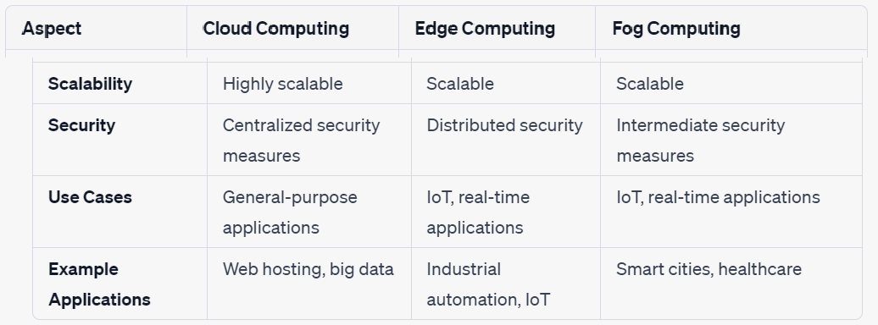
Cloud Vs Edge Vs Fog

Slide 37
Module-1- L7
CO1:Explain the hierarchical architecture of fog and edge computing.
CO2: Describe the function of each layer in the fog–edge hierarchy

Slide 38
Hierarchy of Edge Computing technology
Introduction
In IoT (Internet of Things) systems, massive amounts of data are generated by sensors, devices, and machines. Traditionally, all this data was sent to the cloud for processing and storage. However, this causes:
High latency (delay)
Network congestion
To solve these issues, Fog and Edge Computing introduce intermediate layers between the devices and the cloud — creating a hierarchical architecture.

Slide 39
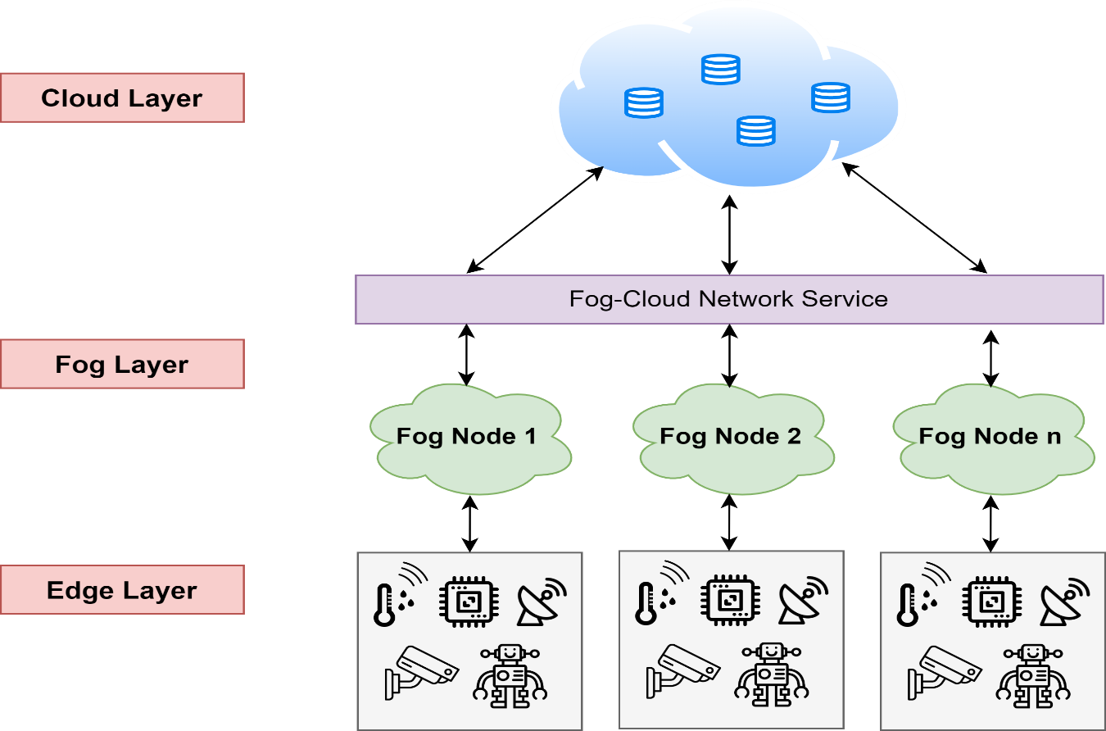
conti...

Slide 40
The hierarchy of Fog and Edge Computing generally consists of three main layers:
1️ Edge Layer (Device Layer)
Location: Closest to end devices or sensors.
Components: IoT devices, sensors, actuators, smartphones, cameras, etc.
Function:
Collects real-time data.
Performs basic processing (e.g., filtering, noise reduction).
Sends relevant data to the next layer (Fog).
Example: A temperature sensor monitoring a machine in a factory.

Slide 41
conti...
2️Fog Layer (Intermediate Layer)
Location: Between the Edge and the Cloud, usually within the local network.
Components: Gateways, routers, micro data centers, fog nodes.
Function:
Performs data aggregation and analysis close to the source.
Reduces the load on the cloud by handling time-sensitive tasks locally.
Provides storage, computation, and networking within the region.

Slide 42
conti...
3️Cloud Layer
Location: Centralized, remote data centers (far from data sources).
Components: Cloud servers, data centers.
Function:
Handles long-term storage and big data analytics.
Runs machine learning models, historical analysis, and large-scale decision-making.
Example: Cloud platform analyzing months of temperature data to predict maintenance schedules.
Hierarchical Flow of Data
Edge Devices → Fog Nodes → Cloud Servers
Each layer performs its own role in processing and passing only necessary data upwards, thereby optimizing latency and network usage.

Slide 43
Module 1 -L8
LO1: Define Inner Edge Device.
LO2:Differentiate Outer Edge and inner Edge Device
LO3 Explain the hierarchy of fog and edge computing deployed layers with a diagram
LO4 Describe the function of each layer in the fog–edge hierarchy

Slide 44
Hierarchy of Fog and Edge Computing
Fog and edge computing are both paradigms that extend cloud computing capabilities
Placed closer to the data source or end-users to reduce latency, improve responsiveness, and enable real-time processing
However, they operate at different proximity levels to the end-users and have distinct characteristics

Slide 45
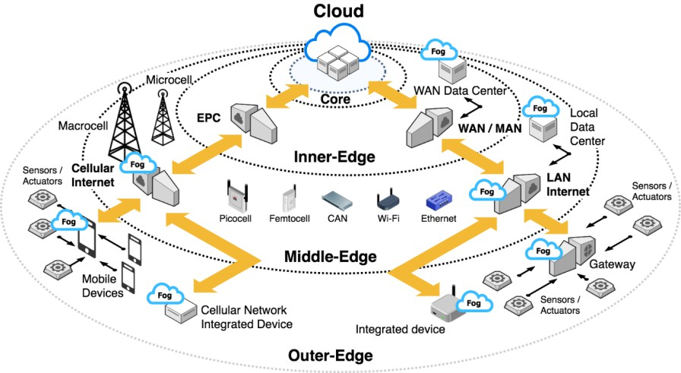
Hierarchy of Fog and Edge Computing
FEC servers deployed at three edge layers—
Inner-edge,
Middle-edge, and
Outer-edge

Slide 46
Hierarchy of Fog and Edge Computing
Inner-edge:
Inner-edge also known as near-the-edge corresponds to countrywide, statewide and regional Wide Area Network (WAN) of enterprises, Internet Service Providers (ISPs), the data centers and Metropolitan Area Network (MAN).
Initially, service providers at inner-edge only offer the fundamental infrastructures for connecting local networks to the global Internet.
However, the recent needs in improving the Quality of Experience (QoE) of Web services have motivated the geo-distributed caching and processing mechanism at the network data centers of WAN

Slide 47
Hierarchy of Fog and Edge Computing
Middle-edge:
Middle-edge corresponds to the environment which consists of two types of networks— Local Area Network (LAN) and cellular network.
LAN includes ethernet, Wireless LAN (WLAN) and Campus Area Network (CAN).
Cellular network consists of the macrocell, microcell, picocell, and -femtocell.
Macrocells typically cover a wide area, such as a city or suburban region.
Microcells have a smaller coverage area
Picocells have an even smaller coverage area than microcells – Indoor Location

Slide 48
Hierarchy of Fog and Edge Computing
Outer-edge:
Outer-edge, which is also known as extreme-edge, far-edge or mist
It represents the front-end of the IoT network which consists of three types of devices— constraint devices, integrated devices and IP gateway devices.
Constraint devices such as sensors or actuators are usually operated by microcontrollers,
Integrated devices are the devices operated by the processors.
IP gateway devices are also known as hubs, which act as the mediator between the constrained devices and the middle-edge devices

Slide 49
Module 1-L9
CO1 Explain the concept of Edge-as-a-Service (EaaS).
CO2 Describe how EaaS platforms simplify edge resource usage
CO3 Describe different types of edge nodes with examples

Slide 50
Eaas
Edge-as-a-Service (EaaS) is a cloud-based service model
--- that provides on-demand access to edge computing resources
— such as compute, storage, networking, and AI capabilities
— located close to end users and data sources.
-- It allows organizations to deploy, manage, and scale edge applications without owning or maintaining edge infrastructure.

Slide 51
Edge Nodes:
Edge Nodes are distributed computing units at the network edge that process data locally to enable low-latency, real-time, and intelligent applications
Edge Nodes are computing units deployed close to data sources (users, sensors, IoT devices) to perform local processing, storage, and analytics, reducing dependency on centralized cloud servers.
Located at the network edge (base stations, gateways, routers)
Support low-latency and real-time processing
Handle data filtering, aggregation, and AI inference
Reduce bandwidth usage and cloud load

Slide 52
Module 1-L10
CO1 Explain the concept of network slicing in edge systems.
CO2 Describe how network slices support with application requirement

Slide 53
Network Slices for Edge Systems,
Network Slicing for Edge Systems refers to creating customized virtual networks that support diverse edge applications with guaranteed Quality of Service (QoS) and Quality of Experience (QoE).Network slicing enables multiple logical edge networks over shared infrastructure, each tailored to specific application requirements.
1.eMBB (Enhanced Mobile Broadband)
High bandwidth
AR/VR, video streaming at the edge
2.URLLC (Ultra-Reliable Low Latency Communications)
Ultra-low latency, high reliability
Autonomous vehicles, industrial automation
3.mMTC (Massive Machine-Type Communications)
Supports large number of devices
Smart cities, IoT sensor networks

Slide 54
conti...

Slide 55
Module-1- L11
Explain the role of Mobile Edge Computing (MEC).
Describe edge and fog computing enhance mobile services.

Slide 56
Edge Computing: Mobile Edge Computing (MEC)
Mobile Edge Computing (MEC) Model:MEC is a specific Edge deployment model focused on mobile networks.
Definition of MEC:Mobile Edge Computing (MEC) provides IT and cloud computing capabilities within the Radio Access Network (RAN), close to mobile users.
Fog nodes are deployed at the edge of cellular networks, providing services to mobile users with reduced latency.
This model enhances mobile applications with real-time capabilities and enables network operators to offer services at the edge
Objective of MEC:
Bring cloud services closer to mobile subscribers
Reduce latency and improve service quality
Similar goal to other edge computing paradigms

Slide 57
Edge Computing: Mobile Edge Computing (MEC)
“Mobile Edge Computing” and “Mobile Edge Cloud Computing” are used interchangeably Both refer to cloud capabilities at the edge of radio access networks
Core MEC Concept:
Reuse existing mobile edge equipment (base stations, access points)
Equipment performs routing, storage, and data processing
MEC Components:
Mobile users
Base stations / access points
MEC servers
Network operator–owned infrastructure

Slide 58
Edge Computing: Mobile Edge Computing (MEC)
Role of Application Service Providers:
Applications hosted in data centers or CDNs
Connected via ISPs
Enables faster, scalable, and reliable mobile services
Benefits of MEC Architecture:
Faster service deployment
Improved reliability and scalability
Reduced sensitivity to latency variations

Slide 59
Edge Computing: Mobile Edge Computing (MEC)
Examples:
▪ Low-latency MEC for connected vehicles
▪ Video analytics
▪ E-commerce transaction management
▪ Road safety and traffic control
▪ High-traffic area customer experience enhancemen

Slide 60
Evolution of MEC:
Integration with Network Functions Virtualization (NFV)
Deployment beyond base stations to cost-effective IP network locations
Increasing integration with IoT scenarios
Initial MEC concepts included machine-to-machine (M2M) communicatio

Slide 61
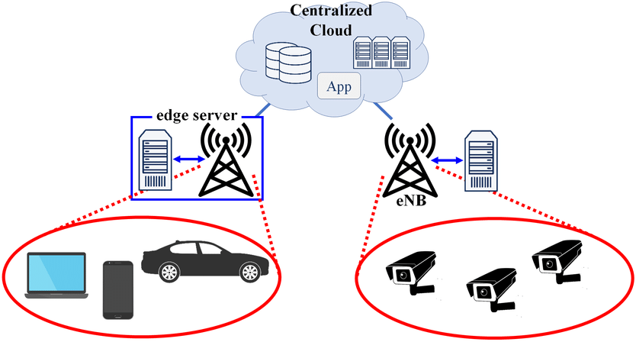
Mobile Edge Computing (MEC) Model:
MEC is a specific edge deployment model focused on mobile networks.
Fog nodes are deployed at the edge of cellular networks,
providing services to mobile users with reduced latency.
This model enhances mobile applications with real-time capabilities and enables network operators to offer services at the edge.

Slide 62
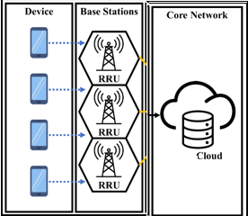
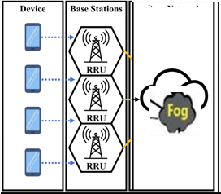
MEC- Model-cloud
MEC- Model-Edge

Slide 63
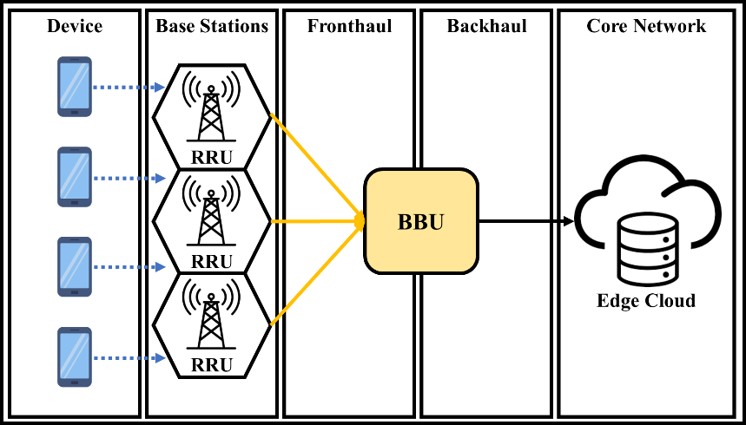
MEC-Model(Conceptual Diagram)

Slide 64
MEC System Model
MEC brings computation closer to users to reduce latency
Users/IoT devices generate tasks with data size Di and CPU cycles Ci
Tasks can be processed locally or offloaded to MEC servers
Decision variable xij decides offloading to MEC server j

Slide 65
MEC Architecture
IoT Devices / UEs → Base Station / AP
Base Station connected to MEC Server
MEC Server connected to Central Cloud
Computation happens at Edge instead of Cloud

Slide 66
Sample questions(2M)
Define Edge Computing.
What is meant by Edge AI?
State any two characteristics of Edge Computing.
What is real-time analytics in Edge AI?
List two differences between Cloud AI and Edge AI.
Mention two benefits of Edge AI over Cloud AI.
What is meant by on-device intelligence?
Give two examples of Edge AI applications.
What is Fog Computing?
Where does Fog Computing lie in the computing hierarchy?
Define Edge Node.
Give two examples of Edge Nodes.
What is Edge-as-a-Service (EaaS)?
State two advantages of EaaS platforms.
What is Network Slicing in Edge systems?
Why is Network Slicing important for Edge Computing?
Define Mobile Edge Computing (MEC).
Mention two use cases of MEC.
What is the main goal of Edge AI in future networks?
List two challenges in deploying AI at the edge.

Slide 67
Scenario based questions
A city has deployed thousands of IoT-enabled traffic cameras and sensors at intersections. Instead of sending all raw data to the cloud, the city installs a single node in each district to process real-time traffic signals and emergency vehicle priority identify the edge deployment model and write the detail description.
A hospital uses wearable health devices to continuously track patients’ vitals. All devices send data to a single server within the hospital before selected information is transmitted to the cloud identify the edge deployment model and write the detail description.
.

Slide 68
Class Test I [ Answer All Questions]
What is the need of edge Computing. [2]
Name the benefits in real time analytics [2]
List any 10 difference between Cloud, Fog and Edge Computing[5]
Explain the hierarchy of fog and edge computing deployed layers with a diagram [5]
Explain MEC Deployment Models in detail (10)

